Slide 1
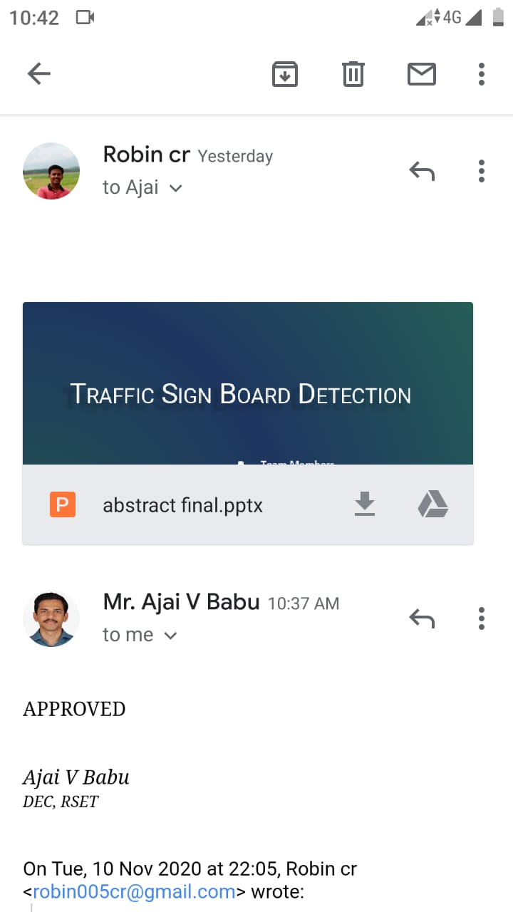

Slide 2
TRAFFIC SIGN BOARD DETECTION
Team Members
Guide
Mr. Ajai V Babu
Assistant Professor
Department of ECE
RSET
ROBIN CR - RET17EC126
SANJAY MS - RET17EC136
VIDHU KRISHNAN - RET17EC178
VS ACHUTHAN - RET17EC186

Slide 3
CONTENTS
TOPIC | PAGE NO
OBJECTIVE BLOCK DIAGRAM BLOCK DIAGRAM EXPLANATION WORK PLAN TIME SPAN SEMINAR TOPICS Mobile Laser Scanning Gabor Filter HOG MSER Algorithm REFERENCE | 1 2 3 4 5 6 7 8 9 10 11

Slide 4
OBJECTIVE
To detect the traffic sign boards and display a message according to the sign.
To create a Traffic sign inventory, which detects the missing sign boards in a city.
1

Slide 5
BLOCK DIAGRAM
Image
Acquisition
Pre processing
Image enhancement
Color segmentation
Displaying message
Sign detection
Feature extraction
Shape detection
2
Fig 1 – Block diagram

Slide 6
BLOCK DIAGRAM (contd.)
Colour segmentation :- Techniques are used to identify the traffic sign board colours mainly red and green.
Shape Detection :- They are implemented to identify the shape of traffic sign boards( triangle and circle).
Feature Extraction :- After identifying colour and shape, object is uniquely found.
Sign Detection:- Various machine learning algorithms are tested for sign detection.
3

Slide 7
WORK PLAN
Traffic sign detection – Robin CR, VS Achuthan
Traffic sign inventory – Sanjay MS, Vidhu Krishnan
Image Processing – OpenCV library in python
Hardware part – Raspberry Pi
4

Slide 8
TIME SPAN
0 – 30%
30 – 60%
60 – 100%
Dataset preparation
Pre Processing
Feature extraction
Sign detection
Testing algorithms
Creating database for traffic sign
Hardware implementation
NOV – DEC
JAN – FEB
MAR – APR
5

Slide 9
SEMINAR TOPICS
Mobile Laser Scanning (MLS) – Sanjay MS
Gabor Filter – Robin CR
Histogram of Oriented Gradients (HOG) – VS Achuthan
Maximally Stable Extremal Regions (MSER) – Vidhu Krishnan
6

Slide 10
MOBILE LASER SCANNING – Sanjay MS
MLS is a land surveying method that uses laser systems mounted on moving vehicles [4].
It can collect 3D surface information along the driving paths.
It is mainly used for geo localization.
Since traffic boards are stationary, coordinates are mapped with the help of MLS.
7

Slide 11
GABOR FILTER – Robin CR
Special classes of bandpass filters [2].
They are used for edge detection and feature extraction.
Possess optimal localization properties in both spatial and frequency domain.
It is effective for shape detection.
Most of the sign boards are circle and triangle which is found using Gabor Filter.
8

Slide 12
HOG – VS Achuthan
Histogram of Oriented Gradients [1]
It is a feature descriptor that is used to extract features from a image.
It focuses on structure or the shape of an object.
It is mainly used for object detection.
The image may contains a lot of objects such as vehicles, out of which sign boards are detected.
9

Slide 13
MSER ALGORITHM – Vidhu Krishnan
Maximally Stable Extremal Regions [3]
Method for blob detection in images.
The algorithm extracts a number of covariant regions.
It is mainly used for text detection.
Text in sign boards such as “GO SLOW”, “SCHOOL AHEAD” are detected.
10

Slide 14
REFERENCE
[1] Dimitrios Konstantinidis, Tania Stathaki, Vasileios Argyriou, and Nikolaos Grammalidis,
“Building Detection Using Enhanced HOG–LBP Features and Region Refinement Processes”,
IEEE Journal OF Selected Topics In Applied Earth Observations And Remote Sensing,
Aug.2016.
[2] VLADIMIR TADIC, AKOS ODRY, ATTILA TOTH2, ZOLTAN VIZVARI, AND PETER ODRY,
“Fuzzified Circular Gabor Filter for Circular and Near-Circular Object Detection”,
May. 2020.
[3] Chenggang Yan, Hongtao Xie, Shun Liu, Jian Yin, Yongdong Zhang,and Qionghai Dai,
“Effective Uyghur Language Text Detection in Complex Background Images for Traffic
Prompt Identification”, IEEE Trans. Intell. Transp. Syst. , Jun. 2017.
[4] Changbin You, Chenglu Wen, Cheng Wang ,Jonathan Li, and AymanHabib,
“Joint 2-D–3-D Traffic Sign Landmark DataSet for Geo-Localization Using Mobile Laser
Scanning Data”, IEEE Trans. Intell. Transp. Syst. ,Aug. 2018.
11

Slide 15
THANKYOU

